Slide 1

307307 Introduction Neural Networks

Slide 2
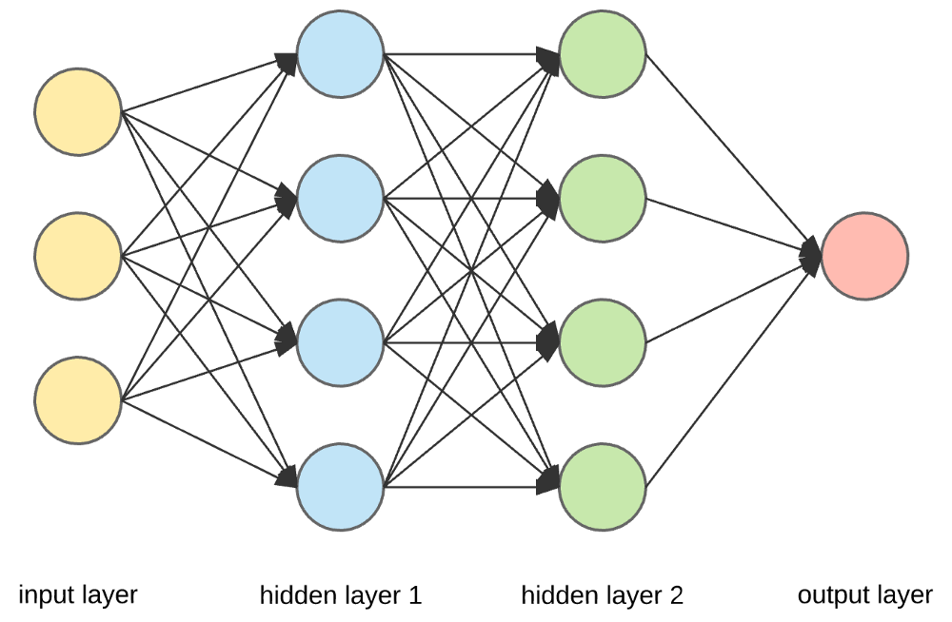
What is a Neural Network?
A neural network is a computational model inspired by the human brain.
It consists of layers of interconnected nodes (neurons) that process data.
Used for pattern recognition, decision-making, and AI applications.

Slide 3
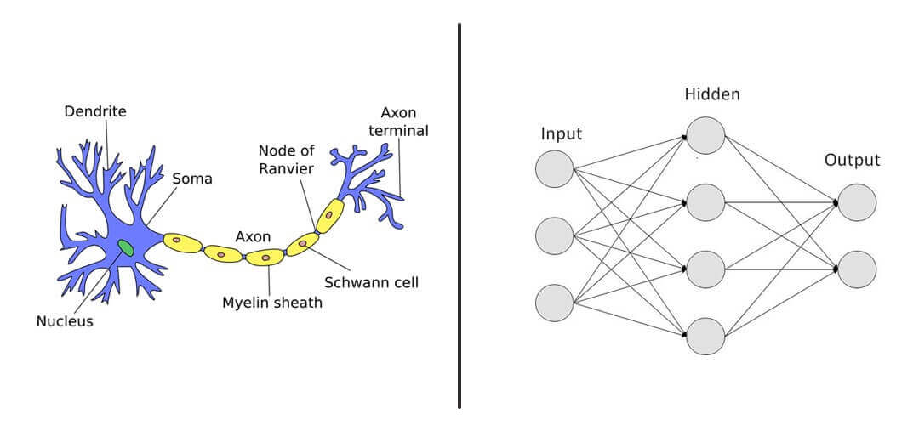
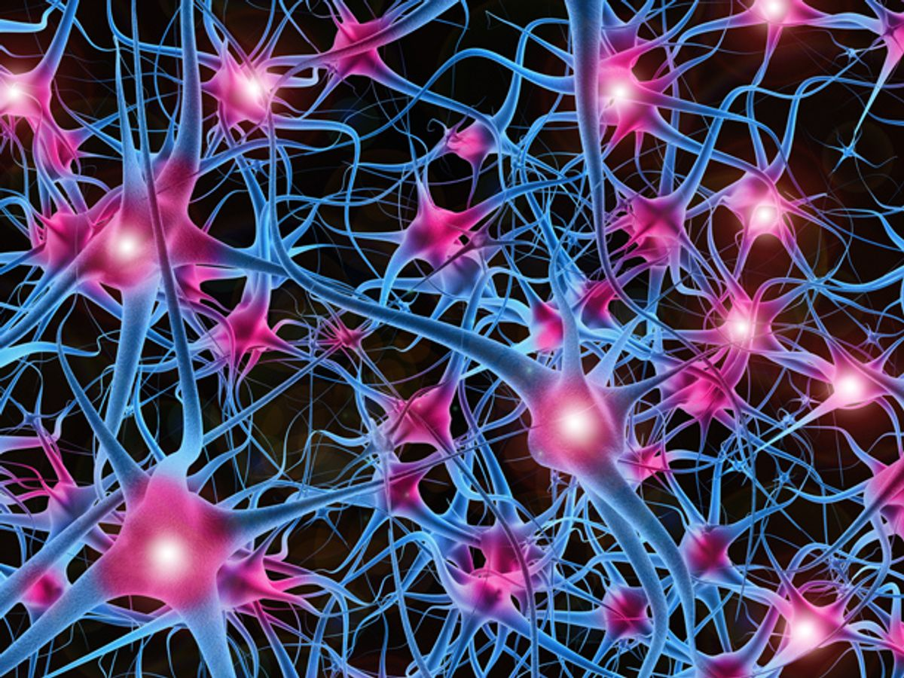
Inspiration from the Human Brain
Neural networks are modeled after biological neurons in the brain.
Neurons receive inputs, process them, and pass the output to other neurons.
Just like the brain, networks learn from experience (training).

Slide 4
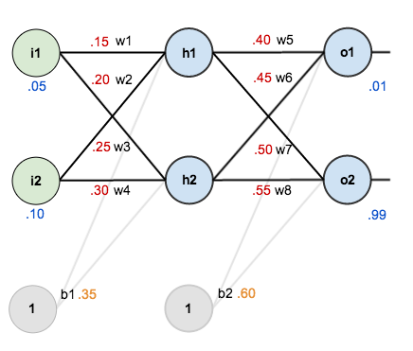
Structure of a Neural Network
Three main layers:
Input Layer – Receives raw data.
Hidden Layers – Process information using mathematical operations.
Output Layer – Produces the final result.
Each connection has a weight, which determines importance.

Slide 5
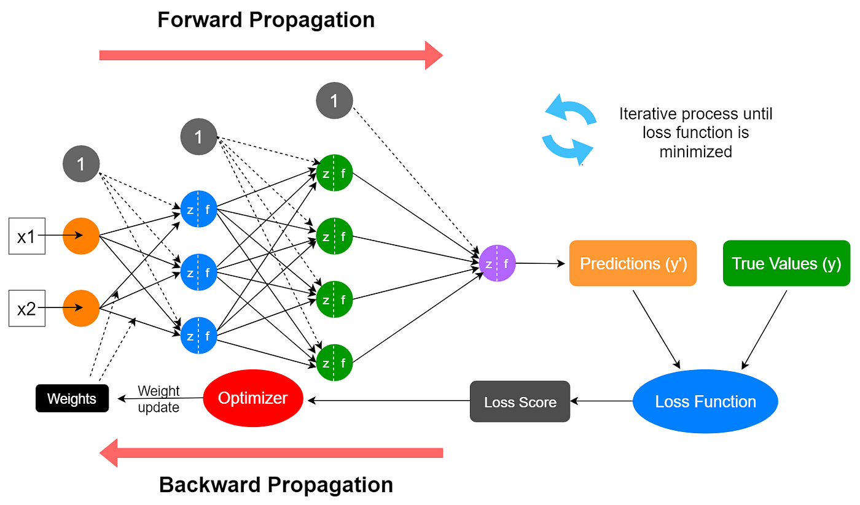
How Neural Networks Learn
Training Process:
Feed data into the network.
Compute the output using weights.
Compare the output with the correct answer (loss calculation).
Adjust weights using backpropagation & gradient descent to improve accuracy.

Slide 6
Types of Neural Networks
Feedforward Neural Network (FNN) – Basic type; flows in one direction.
Convolutional Neural Network (CNN) – Used for image recognition.
Recurrent Neural Network (RNN) – Processes sequential data like speech.
Transformer Models – Advanced networks for NLP (e.g., GPT, BERT).
https://towardsai.net/p/deep-learning/main-types-of-neural-networks-and-its-applications-tutorial-734480d7ec8e

Slide 7
Applications of Neural Networks
Image Recognition (e.g., Face Detection, Object Recognition)
Natural Language Processing (e.g., Chatbots, Translation)
Speech Recognition (e.g., Siri, Google Assistant)
Medical Diagnosis (e.g., Detecting diseases from X-rays)

Slide 8
Challenges & Limitations
High computational cost – Needs powerful hardware (GPUs, TPUs).
Large datasets required – More data = better accuracy.
Black-box nature – Difficult to interpret decisions.
Overfitting – Model may memorize instead of generalizing.

Slide 9
Future of Neural Networks
More efficient architectures (e.g., Transformer models).
Quantum AI – Using quantum computing for better performance.
Smaller & faster models for edge devices (e.g., mobile AI).
Ethical AI – Addressing bias, fairness, and transparency.

Slide 10
How Does Neural Networks Work?

Slide 11
Neural Networks Intuition
Suppose we have this data, and we want to build a model that establishes the relationship between x and y e.g. y = a * x
One can clearly make out that y = 4 * x.
But how can a neural network derive the relationship between y and x?
x | y
0 | 0
1 | 4
2 | 8
3 | 12
4 | 16

Slide 12
How can a neural network find the value of a?
Step1: Random Guess
We need to start somewhere, we can randomly guess the desired multiplier is 2.
The relationship will now look like y = 2 * x
Step 2: Forward Propagation
Here we are propagating the calculation forward from the input —> output.
So now the table would look like this:
X | Predicted Y’
0 | 0
1 | 2
2 | 4
3 | 6
4 | 8

Slide 13
Calculate the Error
Step 3: Error
Let us compare the prediction versus the actual.
We calculate the error as the square of deviation of the actual from the predicted y’. This way we penalize the error irrespective of the direction of error.
x | Actual y | Predicted y’ | Squared error(y-y’)²
0 | 0 | 0 | 0
1 | 4 | 2 | 4
2 | 8 | 4 | 16
3 | 12 | 6 | 36
4 | 16 | 8 | 64
TOTAL |  |  | 120

Slide 14
Minimize Error
Step 4: Minimize Error
The next logical step is to minimize the error, we randomly initialized 2 as the multiplier.
Based on that, the error was 120, we can try to deal with many other values ranging from -100 to 100.
Since we know the real value (4), we will end up with the correct value quickly.
But, in practice, when you deal with a lot more variables (here there is only one: x) and with more complex relationships, trying out different random values for x is not scalable, and not an efficient use of computing resources.

Slide 15
The Derivates Method إيجاد الحل باستخدام الاشتقاق أو معدل تغير الاقتران
A popular way to solve this problem is with the help of differentiation or derivatives.
Basically, derivatives are the rate of change of a function with respect to one of its variables.
In our example, it is the rate of change in the error or loss function with respect to x.
To observe the effect of change, let’s change the multiplier or weight or the parameter from 2 to 2.0001 i.e. increase it by 0.0001 and decrease it by the same amount.
In practice, this increase is even smaller, let us observe the impact:
x | Actual y | Weight = 2 | Squared Error @ 2 | Weight = 2.0001 | Squared Error @ 2.0001 | Weight = 1.9999 | Squared Error @ 1.9999
0 | 0 | 0 | 0 | 0 | 0 | 0 | 0
1 | 4 | 2 | 2 | 2.0001 | 3.99 | 1.9999 | 4.0004
2 | 8 | 4 | 16 | 4.0002 | 15.99 | 3.9998 | 16.0016
3 | 12 | 6 | 36 | 6.0003 | 35.99 | 5.9997 | 36.0036
4 | 16 | 8 | 64 | 8.0004 | 63.99 | 7.9996 | 64.006
4 | 16 | 8 | 64 | 8.0004 | 63.99 | 7.9996 | 64.006
TOTAL |  |  | 120 |  | 119.988 |  | 120.012

Slide 16
The Derivates Method
With the increase in weight by 0.0001, the loss decreased by 0.012 and with a decrease in weight, the loss increased by 0.012.
For a 0.0001 increase in weight, the loss decreased by 120 times (0.012 / 0.0001).
So how much should we increase our weight to reduce the loss?
If we take a different arbitrary number such as 7, the loss increases to 270. So, we know now that the weight should be somewhere between 2 and 7.
Findings:
• If we decrease the weight from 2, the loss increases
• If we increase the weight from 2, the loss decreases up to a point and then it increases as loss is high at weight = 7

Slide 17
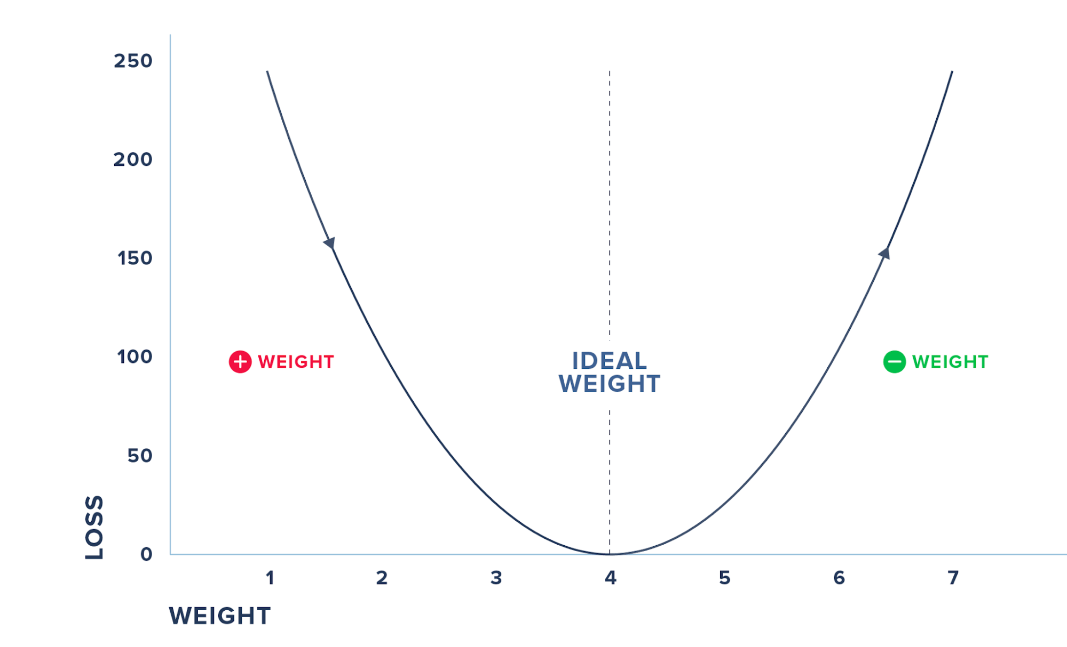
The Derivates Method
We cannot do this iterative process of randomly checking for various weights and arriving at the magical parameter. Moreover, in practice, you will have to deal with many input variables and not just one. Hence, we use derivatives where we check the effect on loss for a small change in the input.
The previous figure summarizes the steps where we check for the derivative and increase the weights, if the loss decreases and vice-versa before we hit the weight where the loss reaches 0. We do this iteratively and update the weights and the loss till we minimize the loss to 0.
The process by which we calculate the derivatives needed in the calculation of weights is called back propagation.

Slide 18
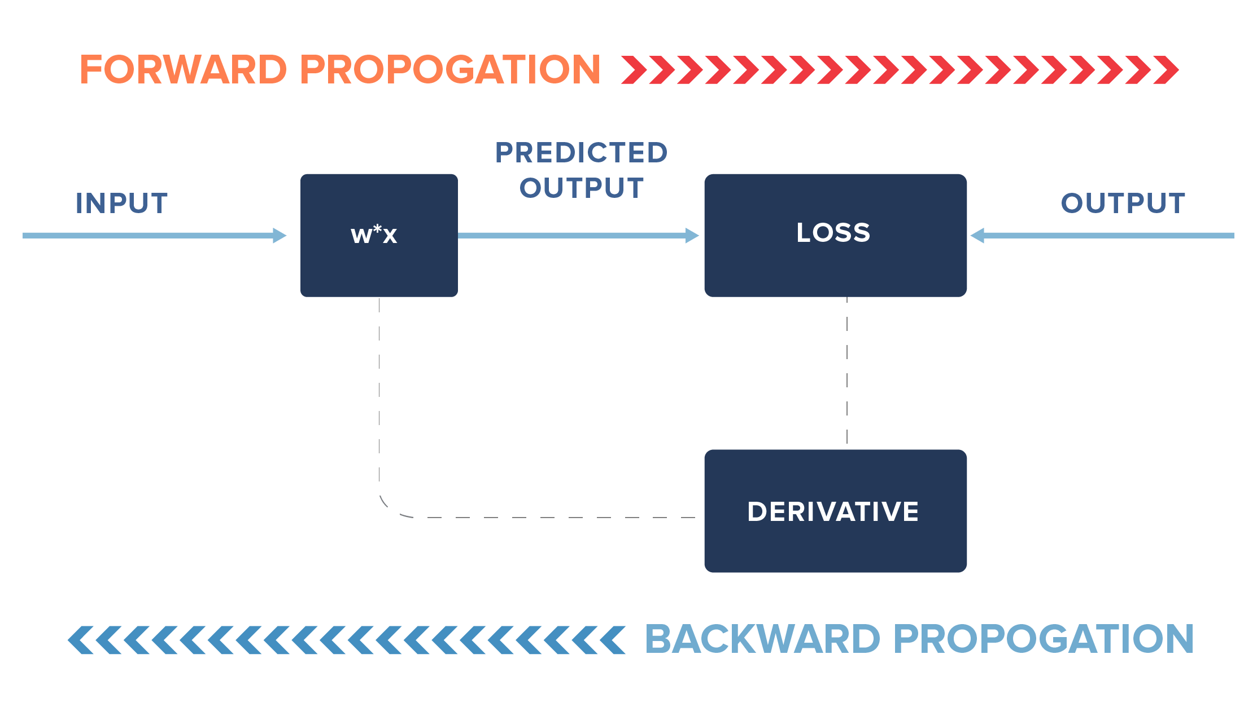
The Derivates Method
In practice, we may not update our weights fully but only by a fraction of the new learned change in weights (i.e. instead of 0.0001, we may update it by a fraction of 0.0001).
Additionally, we may stop earlier than the loss reaches 0, say for example, we may stop if the loss reaches 0.000001.

Slide 19
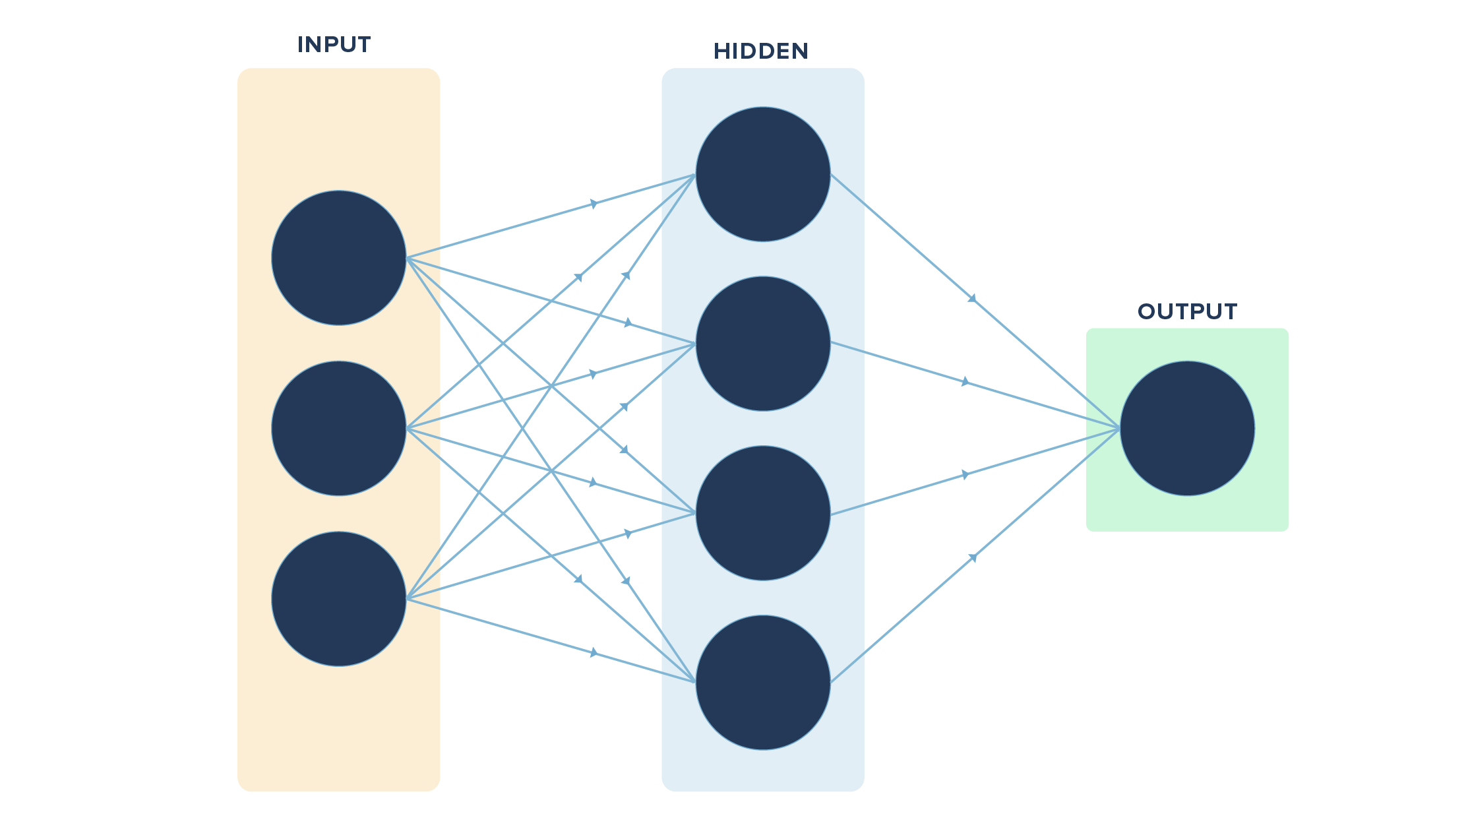
The Derivates Method
But wait, this is not how we generally imagine or view neural networks. It looks more like this:
So, what’s so different from our example?
The key differences are in the number of variables used (multiple vs. one in our case), the layers in between the input and the final output (hidden layers, which are missing in our example) and the output (multiple vs. one in our case).
If we convert our example visually, it will look like this:

Slide 20
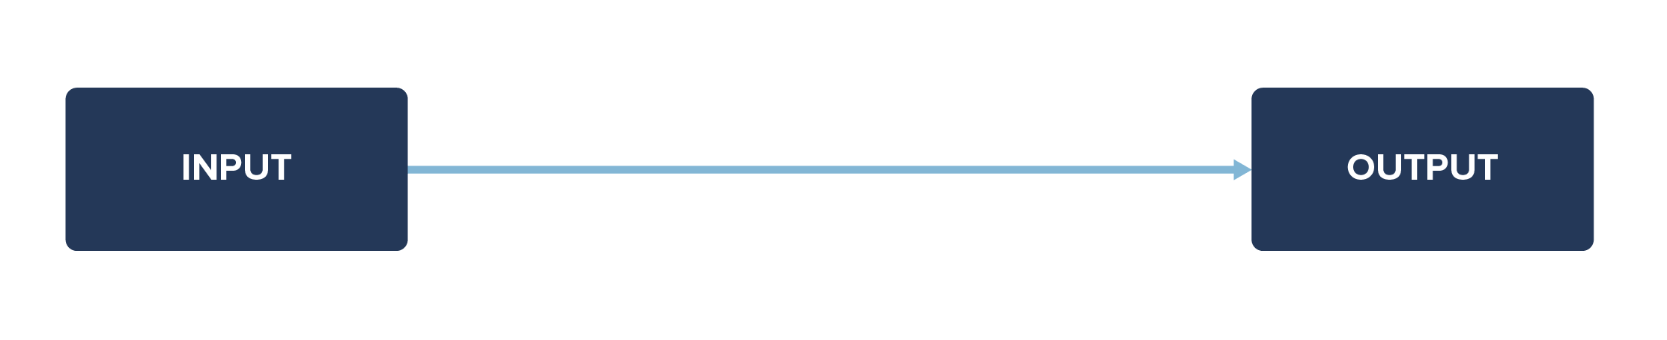
The Derivates Method
So, what’s so different from our example?
The key differences are in the number of variables used (multiple vs. one in our case), the layers in between the input and the final output (hidden layers, which are missing in our example) and the output (multiple vs. one in our case).
If we convert our example visually, it will look like this:
We had a simple task/function in hand to learn. What if we had a complex function to learn with many input variables ranging from x1, x2, ……, xn (n variables)?
It may not be possible to learn everything directly. So, we may have layers between the input and output layers to make it easier for the neural net to learn the function.

Slide 21
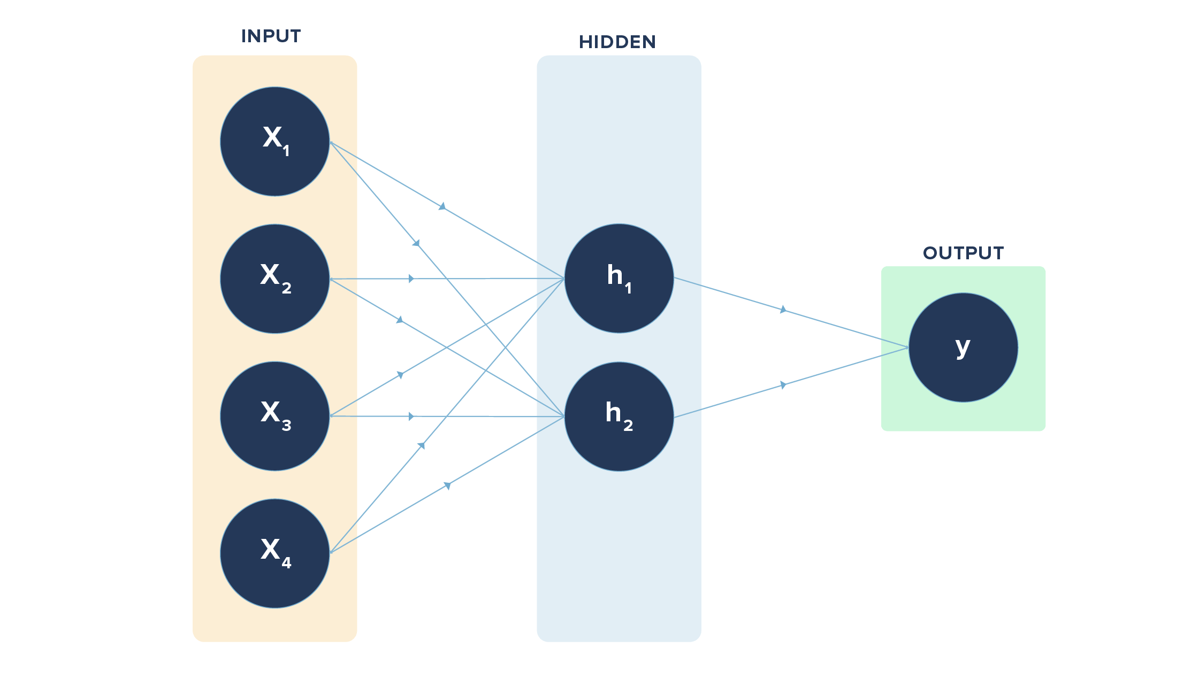
The Derivates Method
In the diagram shown on the right, we have 4 inputs or nodes in the input layer, 2 nodes in the hidden layer, and 1 node in the output layer.
The lines indicate the connection each node has with the node in the layer following it.
The connections are through the weights involved, which are learned via forward and back propagation.
h1 = x1 * w1 + x2 * w1 + x3 * w1 + x4 * w1
h2 = x1 * w2 + x2 * w2 + x3 * w2 + x4 * w2
Here, “w” refers to weights connecting input layer to hidden layer. Likewise, we have a set of weights from hidden layer to output layer. The earlier case had just one of the input nodes and one output node with the connection.
In case we are tasked with classifying items such as digits from 0 to 9 (multi-class output), we will have 10 nodes (each digit represented by one node) in the output layer instead of one. Likewise, we can have multiple hidden layers too.

Slide 22
Code Examples

Slide 23
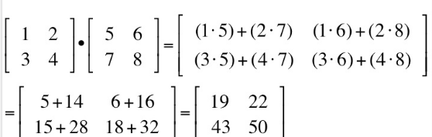
A Simple "Neuron" in Python
import numpy as np
# Inputs (features)
inputs = np.array([1.0, 2.0, 3.0]) # Example input data
# Weights (coefficients)
weights = np.array([0.5, -0.2, 0.3]) # Randomly chosen weights
# Bias (extra term)
bias = 0.7
# Compute output (weighted sum + bias)
output = np.dot(inputs, weights) + bias
print("Output of the neuron:", output)
Explanation:
Computes 1.0*0.5 + 2.0*(-0.2) + 3.0*0.3 + 0.7
Uses dot product (matrix multiplication).

Slide 24
The Perceptron – Sample as Previous only with a Step Function
import numpy as np
# Step activation function (Binary output: 0 or 1)
def step_function(x):
return 1 if x > 0 else 0
# Inputs and weights
inputs = np.array([1.0, 2.0, 3.0])
weights = np.array([0.5, -0.2, 0.3])
bias = 0.7
# Compute output
output = np.dot(inputs, weights) + bias
perceptron_output = step_function(output)
print("Perceptron output:", perceptron_output)
A perceptron typically includes a step activation function (e.g., y = 1 if output > 0 else 0).
Without activation, it’s just a linear function (weighted sum).
The step_function ensures binary classification (0 or 1).
If output is positive, perceptron fires (1); otherwise, it doesn’t (0).

Slide 25
A Simple Neural Network (No Libraries)
import numpy as np
# Sigmoid activation function
def sigmoid(x):
return 1 / (1 + np.exp(-x))
# Inputs
inputs = np.array([0.5, 0.3]) # Two inputs
# Weights for hidden layer (2 inputs → 2 neurons)
weights_hidden = np.array([[0.4, 0.7], [-0.2, 0.5]])
# Bias for hidden layer
bias_hidden = np.array([0.1, 0.2])
# Compute hidden layer output
hidden_layer_input = np.dot(inputs, weights_hidden) + bias_hidden
hidden_layer_output = sigmoid(hidden_layer_input)
print("Hidden layer output:", hidden_layer_output)
Explanation:
Uses sigmoid activation to keep values between 0 and 1.
Basic feedforward step for two neuron

Slide 26
Building a Neural Network using TensorFlow/Keras
import tensorflow as tf
from tensorflow import keras
import numpy as np
# Generate dummy data (X: features, y: labels)
X = np.array([[0, 0], [0, 1], [1, 0], [1, 1]]) # Inputs (XOR gate)
y = np.array([[0], [1], [1], [0]]) # Expected output (XOR results)
# Create a simple neural network
model = keras.Sequential([
keras.layers.Dense(4, activation='relu'), # Hidden layer (4 neurons)
keras.layers.Dense(1, activation='sigmoid') # Output layer (1 neuron)
])
# Compile the model
model.compile(optimizer='adam', loss='binary_crossentropy', metrics=['accuracy'])
# Train the model
model.fit(X, y, epochs=100, verbose=0) # Train for 100 epochs silently
# Make a prediction
prediction = model.predict(X)
print("Predictions:", prediction)
Explanation:
Uses Keras to create a simple XOR classifier.
ReLU for hidden layer, sigmoid for binary classification.
Trains for 100 epochs to find best weights.

